Slide 1
Lending Club Case Study
Prepared by: Ejaz Sayyed
Manikandan

Slide 2
Agenda
Problem Statement
Technologies Used
Data Understanding
Analysis
Conclusion(s)

Slide 3
Problem Statement
Understand the driving factors (or driver variables) behind loan default, i.e., the variables which are strong indicators of default

Slide 4
Technologies Used
We have used below technologies for analysis
Python – Open-source language best suited for handling data. Python provides rich libraries like matplotlib & seaborn for visualization and many other libraries for statistical analysis and data manipulation
Jupyter Notebooks – An open-source web application to create and share documents that contain live code (e.g. Python), equations, visualizations, and narrative text.

Slide 5
Data Understanding – As-IS
After analyzing the raw data, below are the initial observations:
39717 records with 111 columns
Enough columns to derive the useful metrics and perform loan default analysis
But also, more than 50 columns which had no data
Many attributes which are not required for this analysis
Some missing values in the data

Slide 6
Data Cleansing Activities
We used below techniques to cleanse the data and make it suitable for analysis -
Fill in some columns with missing values i.e. imputation (using mean, median, mode techniques)
Converted columns from String to Day/Month/Year
Removing columns where ‘all’ values are null
Dropping columns which are not relevant for this analysis
Converting few column values from String to Integer/Float for analysis

Slide 7
Analysis on Data - I
Univariate Analysis (i.e. using one variable/field/column/attribute at a time)

Slide 8
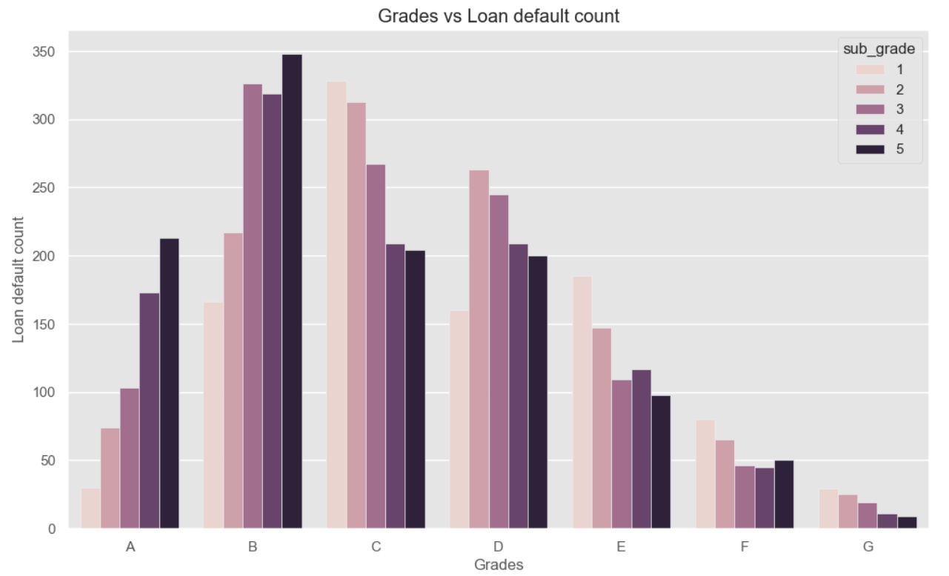
Observation 1
Many defaulters are from B and C grades and specifically, borrowers from 5th subgrade of B are higher in %.

Slide 9
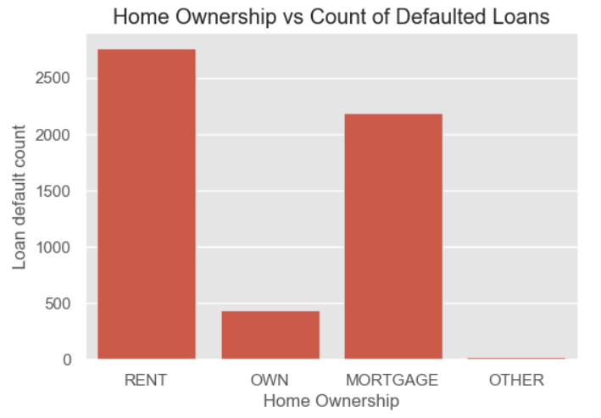
Observation 2
Loan Defaulters have ‘Home Ownership’ mostly as ‘Rent’ or ‘Mortgage’

Slide 10
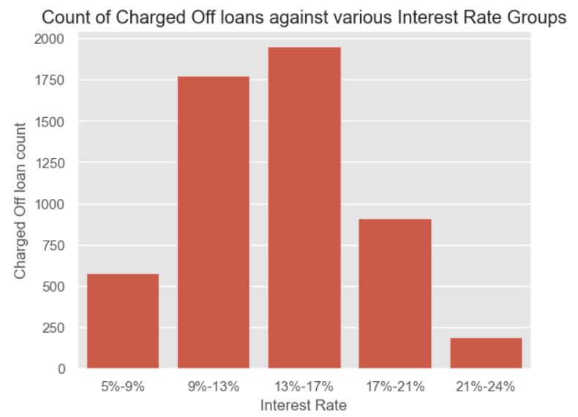
Observation 3
Loans are ‘Charged Off’ or ‘Defaulted’ when ‘Interest Rate’ is high.

Slide 11
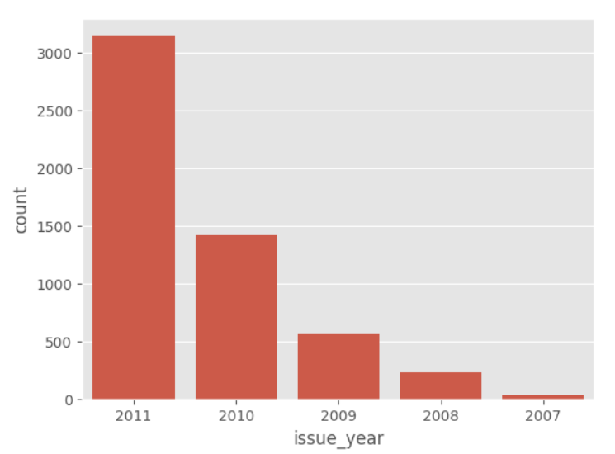
Observation 4
Most Loan defaults have occurred in year 2011.

Slide 12
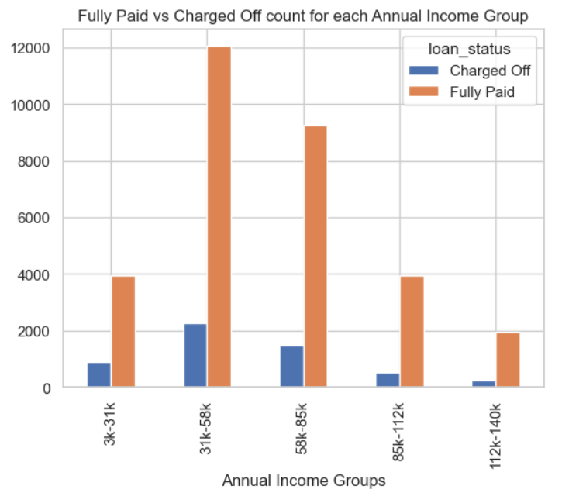
Observation 5
Charged Off (i.e. Defaulters) count is high in the annual income group of 31k-58k.

Slide 13
Analysis on Data - II
Bivariate or Multivariate Analysis (i.e. using two or more variables/fields/columns/attributes at a time)

Slide 14
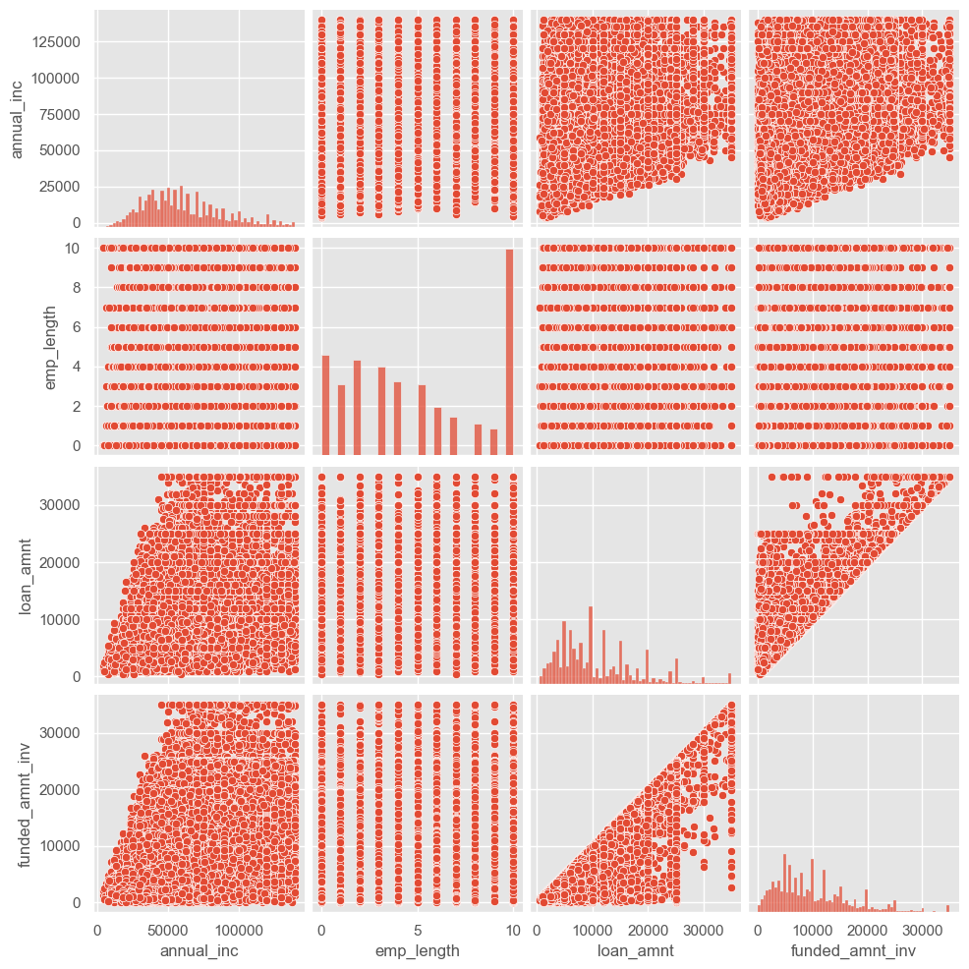
Observation 6
This is called as Pairplot and is used to show relationship between multiple variables/attributes in the dataset.
From the graph, it can be observed that –
- Loan Amount and Funded Amount are related
- No relationship between Employment Length/Duration and Loan Amount!

Slide 15
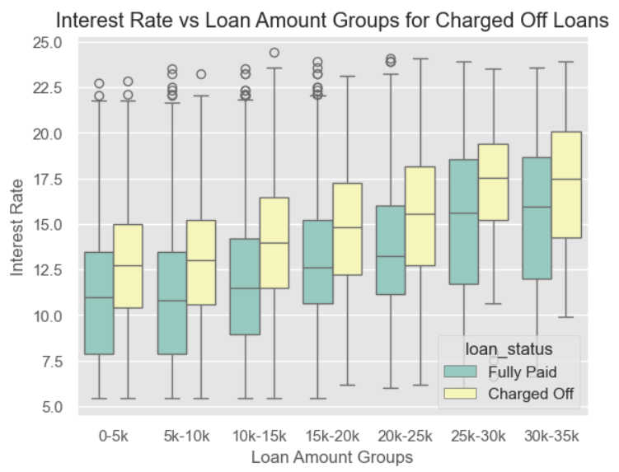
Observation 7
For high loan amounts, more interest is being charged for the loans which are defaulted.

Slide 16
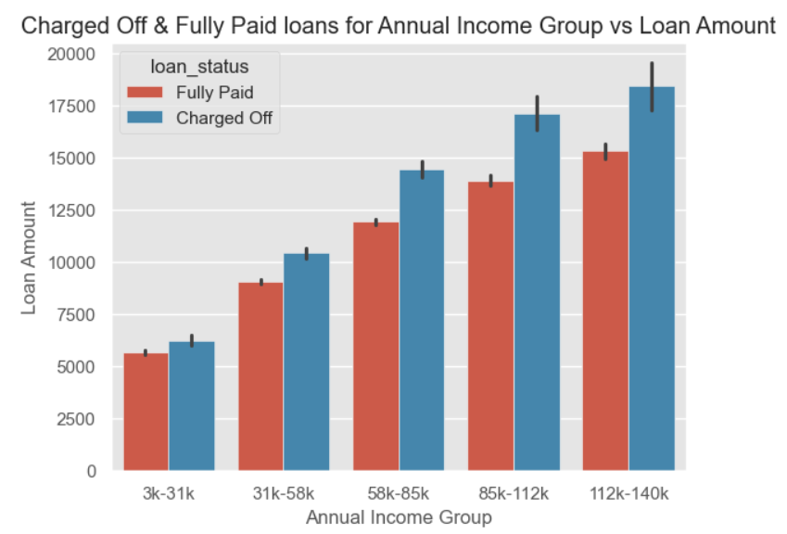
Observation 8
As the Loan Amount gets higher, % of loan defaults is increased. These high amount loans are taken by people with high annual income.

Slide 17
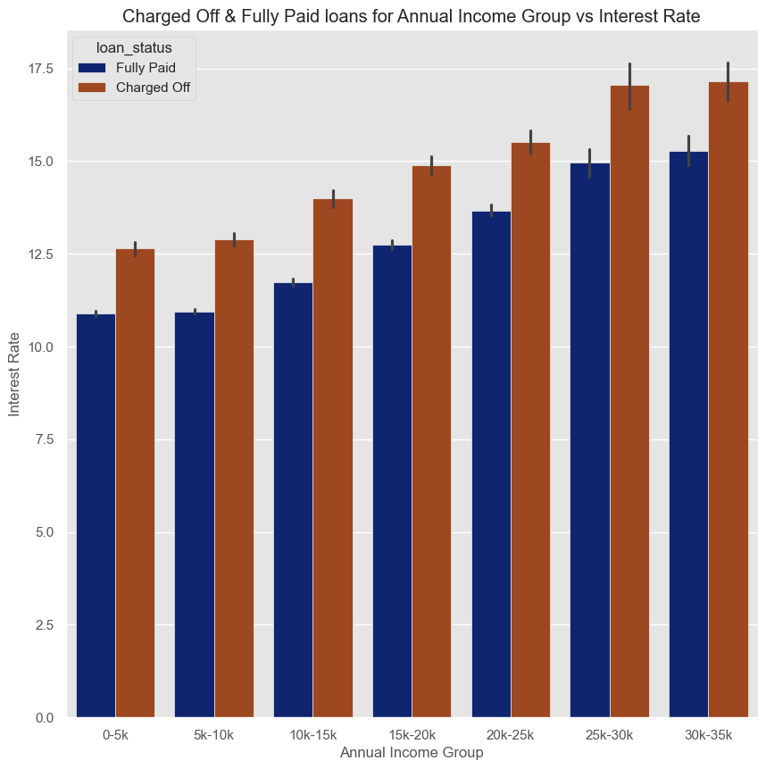
Observation 9
High Interest Rate Loans are taken by people with high Annual Income.
‘Fully Paid’ Loans are always taken at Low Interest Rates than ‘Charged Off’ loans.

Slide 18
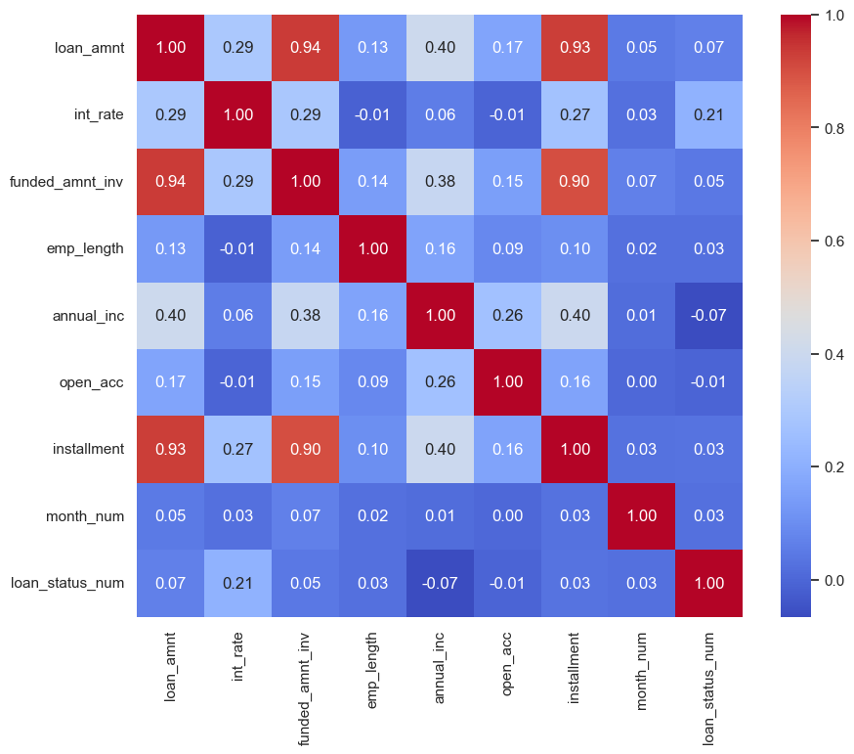
Observation 10
Heatmap is shown. It shows relationship of various attributes with every other attribute.
There is high correlation between –
Funded Amount Investment & Installment
Loan Amount & Installment
Loan Status & Interest Rate
There is low correlation between –
Loan Status & Annual Income of a person

Slide 19
Conclusions
Below are the main factors having influence on loan defaults –
Interest Rate (and thus Installment)
Grade
Year (2011) – Can be due to market conditions in the year!
Home Ownership

Slide 20
Thank you

